Slide 1
Shalom School Of Theology (SSOT)
Some Tools You Need To Interpret . . . Narratives

Slide 2
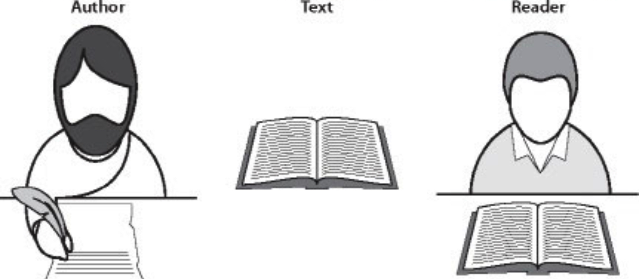
Where Does Meaning Reside?
Basic Components of Communication

Slide 3
Where Does Meaning Reside?
Basic Components of Communication

Slide 4
Where Does Meaning Reside?
Basic Components of Communication

Slide 5
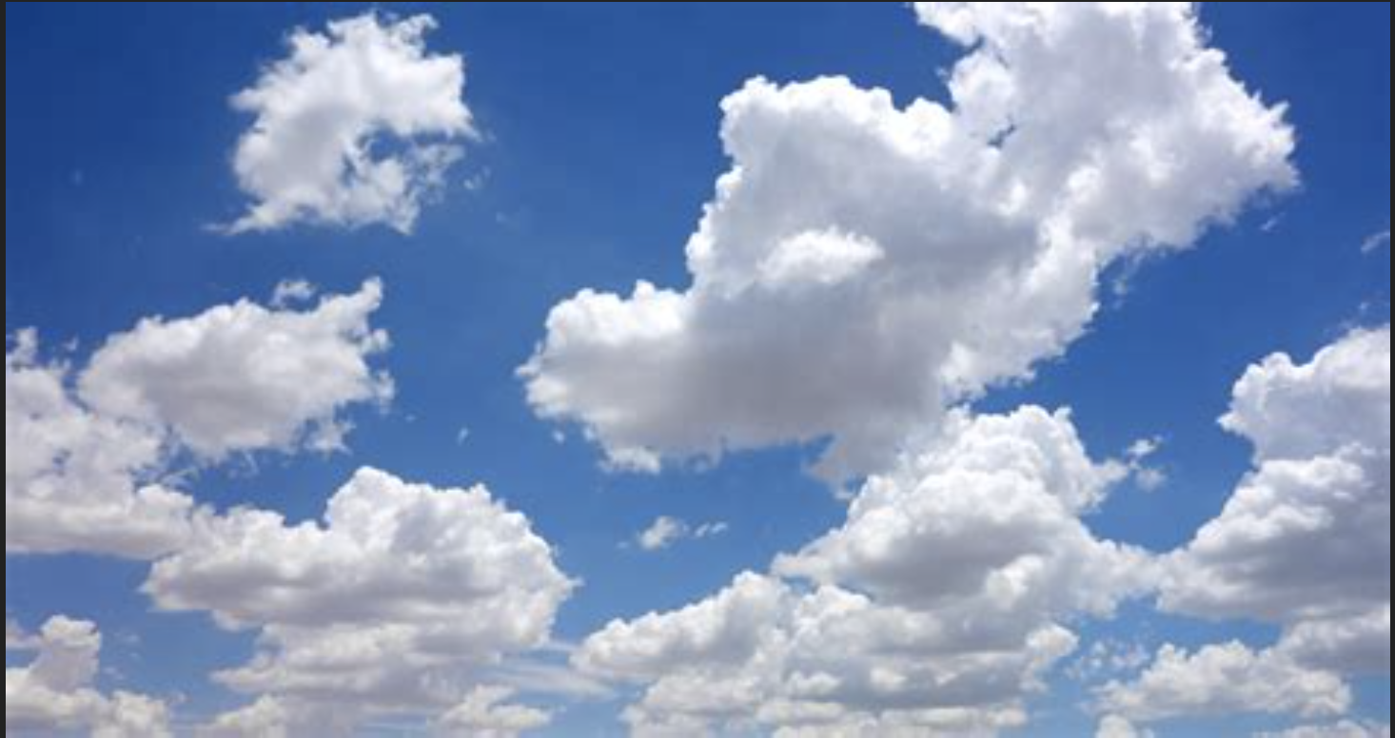

Slide 6
Where Does Meaning Reside?
Basic Components of Communication

Slide 7
Clarifying The Terms We Use
Meaning
The meaning of a text is the principle that an author consciously willed to convey by the words (shareable symbols) used

Slide 8
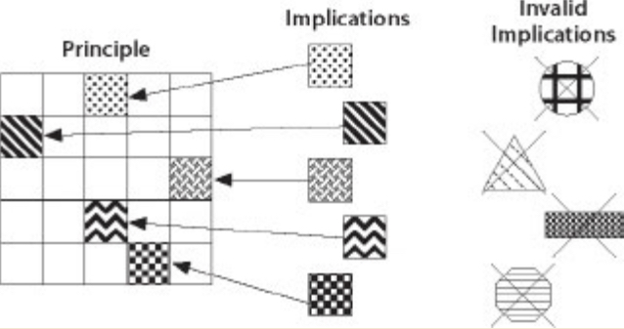
Clarifying The Terms We Use
Meaning
Implications
Implications are those inferences in a text of which an author may or may not have been aware but that nevertheless legitimately fall within the principle he willed

Slide 9
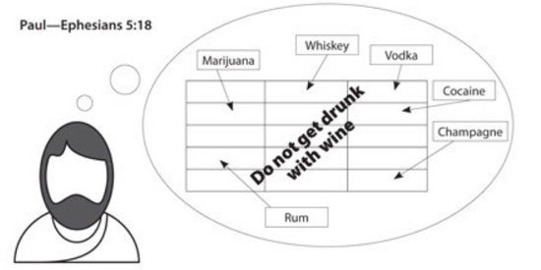
Clarifying The Terms We Use
Meaning
Implications
Implications are those inferences in a text of which an author may or may not have been aware but that nevertheless legitimately fall within the principle he willed

Slide 10
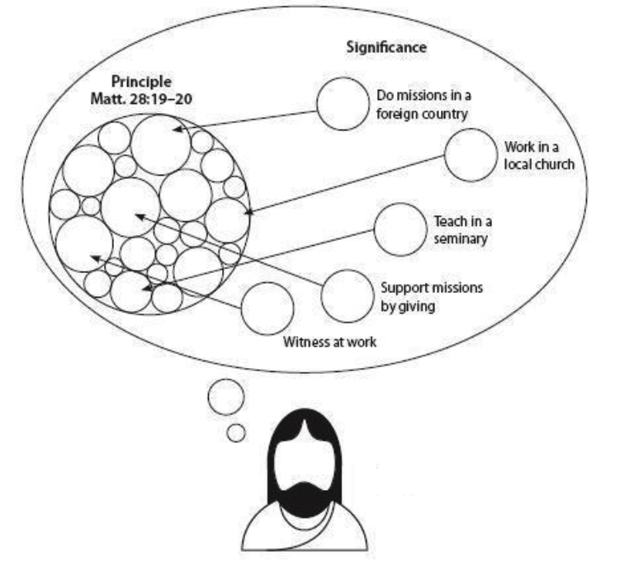
Clarifying The Terms We Use
Meaning
Implications
Significance
Significance refers to how a reader responds to the meaning of a text

Slide 11
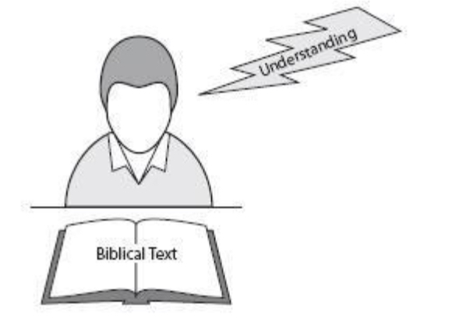
Clarifying The Terms We Use
Meaning
Implications
Significance
Understanding
Understanding refers to the correct mental grasp of an author’s meaning by the reader

Slide 12
Clarifying The Terms We Use
Meaning
Implications
Significance
Interpretation
Understanding
Interpretation
Interpretation refers to the verbal or written expression of a reader’s understanding of an author’s meaning

Slide 13
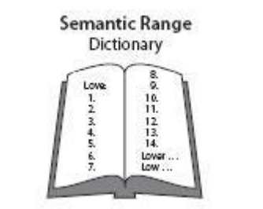
Clarifying The Terms We Use
Meaning
Implications
Significance
Understanding
Interpretation
Semantic Range
The semantic range is the limit of possible meanings allowed by the words (verbal symbols) of a text

Slide 14
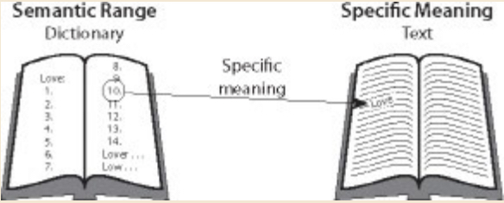
Clarifying The Terms We Use
Meaning
Implications
Significance
Understanding
Interpretation
Semantic Range
Specific Meaning
The specific meaning is the particular meaning that an author has given to a word, phrase, sentence, and the like, in a text

Slide 15
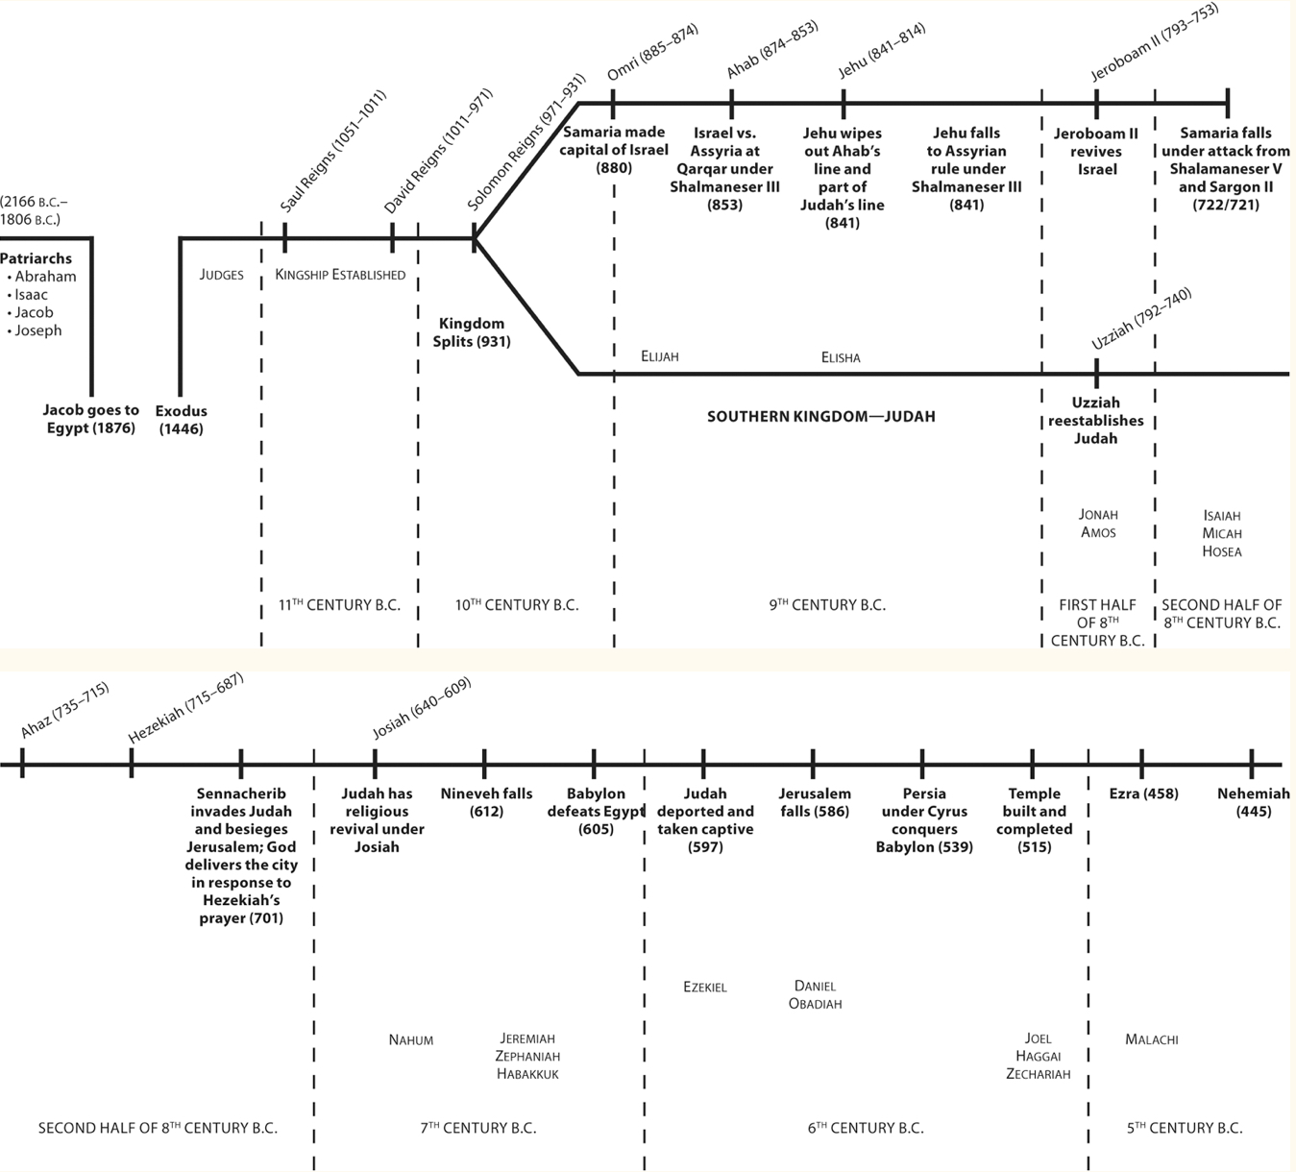
Old Testament Outline

Slide 16
Grappling With Old Testament Narratives
1 SAMUEL 17
Know The Setting
The Immediate Setting
War between the Philistines and Israelites
Israel invaded
Reign of Saul
Valley of Elah

Slide 17
Grappling With Old Testament Narratives
1 SAMUEL 17
Know The Setting
The Immediate Setting
War between the Philistines and Israelites
Israel invaded
Reign of Saul
Valley of Elah

Slide 18
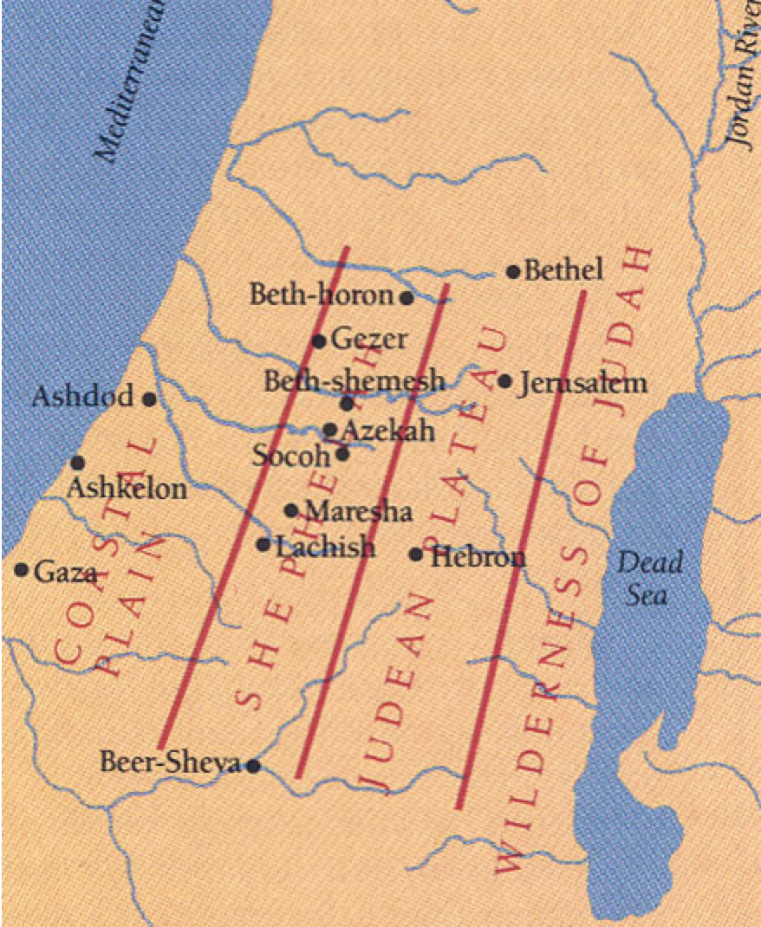
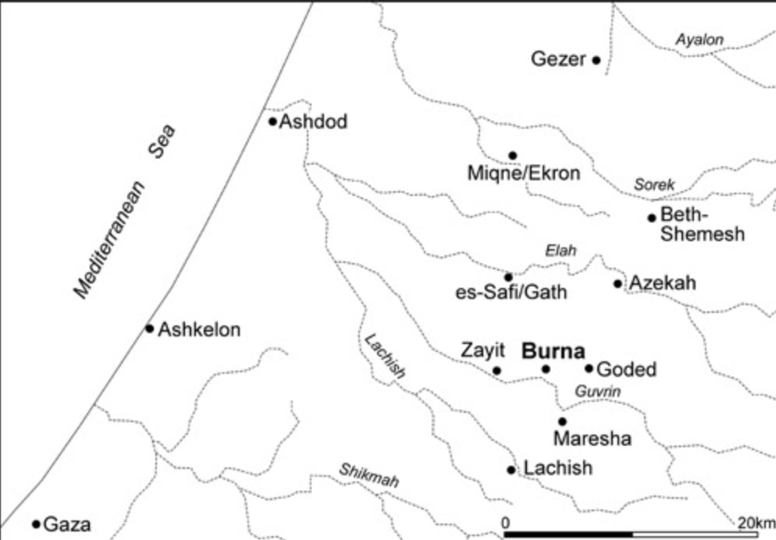
Grappling With Old Testament Narratives
1 SAMUEL 17
Know The Setting
The Immediate Setting

Slide 19
Grappling With Old Testament Narratives
1 SAMUEL 17
Know The Setting
The Immediate Setting
The Wider Setting
Monarchy in Israel
Life
Of
David
David vs.
Goliath

Slide 20
Grappling With Old Testament Narratives
1 SAMUEL 17
Know The Setting
The Immediate Setting
The Wider Setting
The Whole-Bible Setting

Slide 21
Grappling With Old Testament Narratives
1 SAMUEL 17

Slide 22
Grappling With Old Testament Narratives
1 SAMUEL 17
Identify The Characters (Major & Minor)
The central character:
David
The secondary characters:
Goliath
Saul
The supportive characters:
Jesse
Abner
Eliab
Soldiers

Slide 23
Grappling With Old Testament Narratives
1 SAMUEL 17
Identify The Characters (Major & Minor)
The central character:
David
The secondary characters:
Goliath
Saul
The supportive characters:
Jesse
Abner
Eliab
Soldiers
How are they portrayed?
Actions: Good or Bad?
Motives: Good or Bad?
Mixture?
God the Main Character:
What can we learn about HIM?

Slide 24
Grappling With Old Testament Narratives
1 SAMUEL 17

Slide 25
Grappling With Old Testament Narratives
1 SAMUEL 17

Slide 26
Grappling With Old Testament Narratives
Read GENESIS 22:1-19.
Grapple with this narrative using what you have learnt from Know The Setting, Identify The Characters (Major & Minor), Understand The Plot, Locate And Observe The Narrator and Don’t Walk Away Unaffected
Share the fruits of your exercise with the rest of us ☺
~~~~~~~~~~~~~
====
==========
====================================

Slide 27
Grappling With Old Testament Narratives
Read GENESIS 22:1-19.
Grapple with this narrative using what you have learnt from Know The Setting, Identify The Characters (Major & Minor), Understand The Plot, Locate And Observe The Narrator and Don’t Walk Away Unaffected
Share the fruits of your exercise with the rest of us ☺
~~~~~~~~~~~~~
====
==========
====================================
group

